Slide 1

Sales Overview Report
Harsh Kumar Srivastav

Slide 2

Introduction
This report provides a comprehensive analysis of recent sales performance, highlighting key insights into profitability, segment contributions, discount impacts, and regional trends. By evaluating these factors, we aim to identify patterns that influence revenue generation and operational efficiency. The findings will enable stakeholders to make data-driven decisions, optimize pricing strategies, and enhance business growth through informed planning and execution.

Slide 3
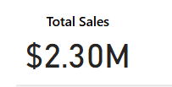
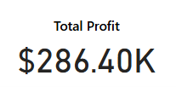
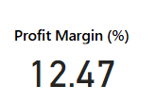
Primary Goals Assess Business Performance
Identify Trends & Patterns
Optimize Decision-Making
Enhance Profitability
Improve Market Position

Slide 4
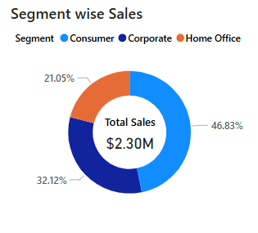
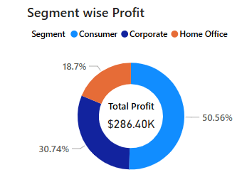
Segment Wise Performance
1. Consumer segment contributes the highest sales (46.83%) and profit (50.56%). 2. The Corporate and Home Office segments generate substantial revenue but have lower profit margins.

Slide 5
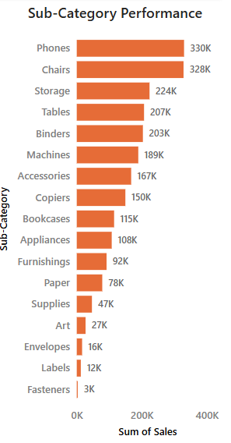
1. Phones, Chairs, and Storage are the highest revenue-generating sub-categories.
2. Fasteners, Labels, and Envelopes contribute the least in sales.
Sub-Category Analysis

Slide 6
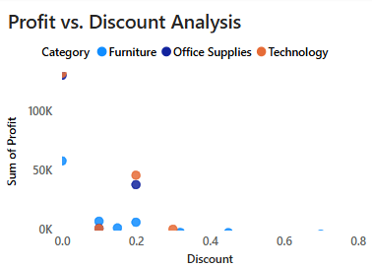
1. Discounts impact profits significantly, especially in Furniture, Office Supplies, and Technology categories.
2. Higher discounts seem to correlate with lower profitability.
Profit vs. Discount Relationship

Slide 7
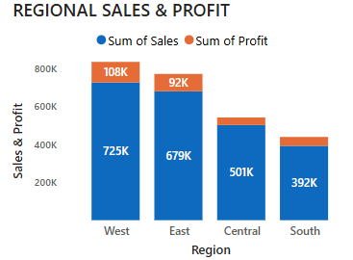
West region leads with the highest sales ($725K) and profit ($108K).
South region has the lowest sales ($392K) but maintains a decent profit margin.
Regional Sales & Profit Trends

Slide 8

Areas of focus
Profit Optimization – Adjust discount strategies to improve profit margins while maintaining competitiveness.
Segment-Specific Strategies – Develop targeted pricing and marketing approaches based on segment profitability.
High-Performing vs. Underperforming Categories – Invest in top-performing products and address inefficiencies in weaker categories.
Regional Growth Opportunities – Strengthen presence in regions with lower sales and leverage high-performing areas for expansion.
Operational Efficiency – Streamline processes to reduce costs and enhance overall business effectiveness.

Slide 9


Summary
This report analyzes sales performance, focusing on profitability, segment contributions, discount impacts, and regional trends. Key findings highlight areas for improvement, such as optimizing discount strategies, refining segment-specific approaches, investing in high-performing product categories, and expanding in underperforming regions. By implementing data-driven strategies, businesses can enhance operational efficiency, maximize revenue, and strengthen market positioning for sustained growth.

Slide 10




Thank you
Harsh Kumar Srivastav
harshkumar88629@gmail.com

